Slide 1
Relational Data Language: SQL

Slide 2
Operations on relations
In a relational database, we can define several operations to create new relations out of the existing ones.
Basic operations:
  Insert
  Delete
  Update
  Select
  Project
  Join
  Union
  Intersection
  Difference

Slide 3
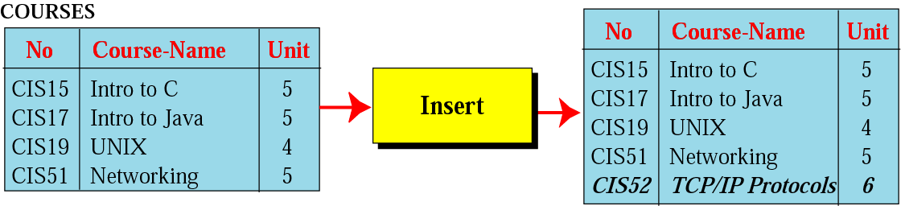
Insert operation
Figure 14-7
An unary operation.
Insert a new tuple into the relation.

Slide 4
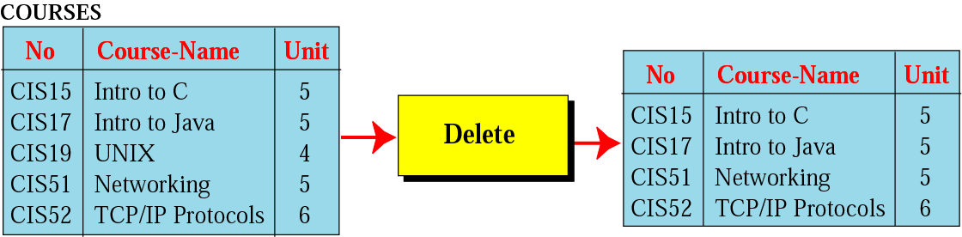
Figure 14-8
Delete operation
An unary operation.
Delete a tuple defined by a criterion from the relation.

Slide 5
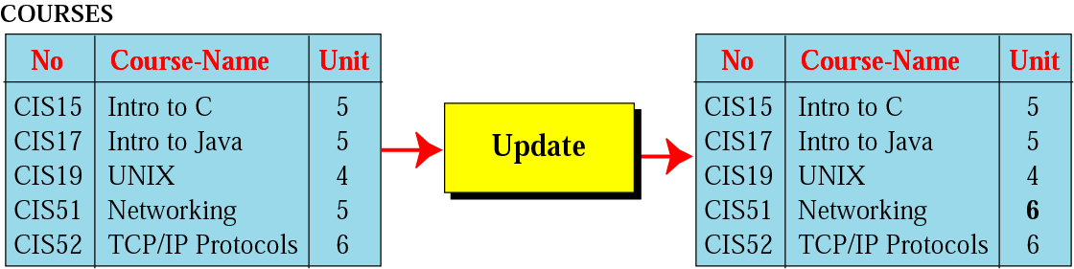
Figure 14-9
Update operation
An unary operation.
Changes the value of some attributes of a tuple.

Slide 6
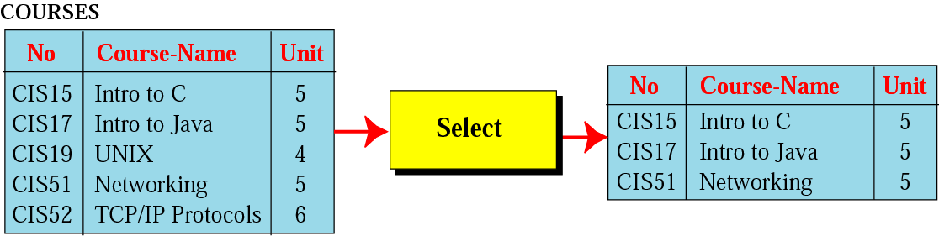
Select operation
Figure 14-10
An unary operation.
It is applied to one single relation and creates another relation.
The tuples in the resulting relation are a subset of the tuples in the original relation.
Use some criteria to select

Slide 7
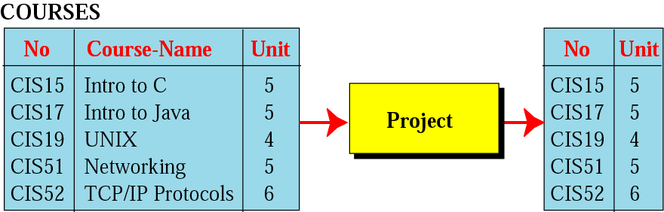
Project operation
Figure 14-11
An unary operation.
It is applied to one single relation and creates another relation.
The attributes in the resulting relation are a subset of the attributes in the original relation.

Slide 8
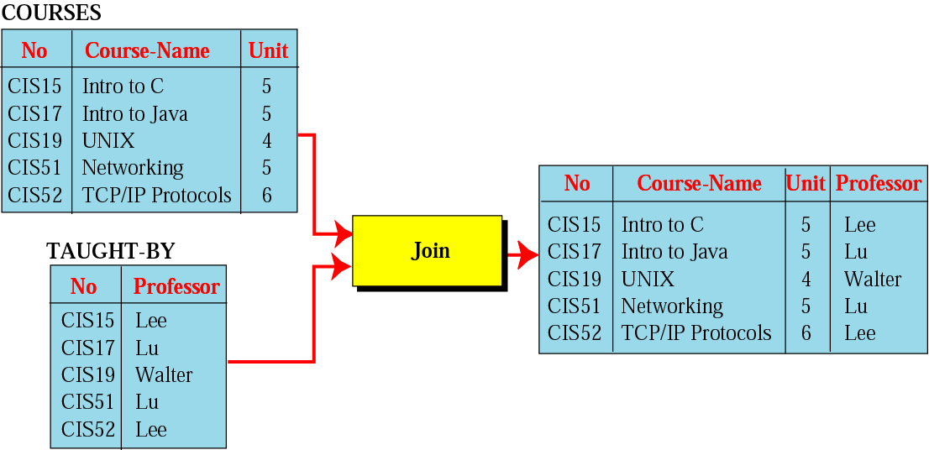
Join operation
Figure 14-12
A binary operation.
Combines two relations based on common attributes.

Slide 9
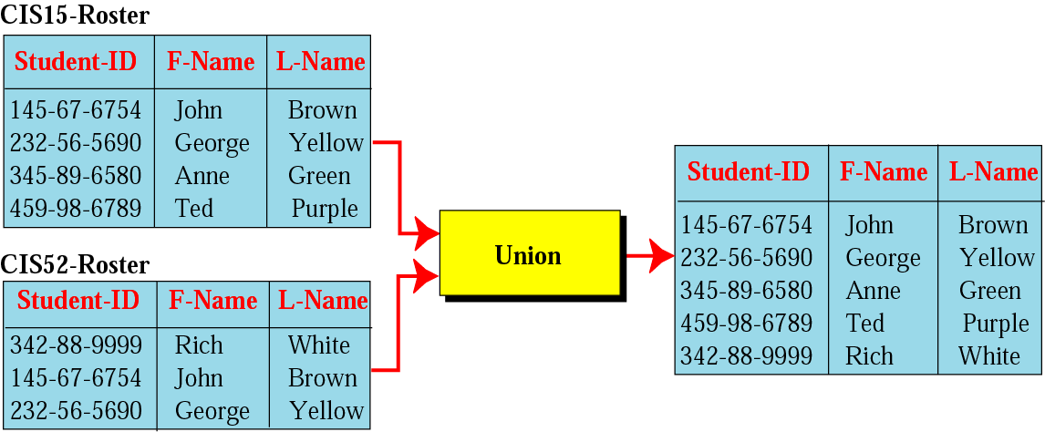
Figure 14-13
Union operation
A binary operation.
Creates a new relation in which each tuple is either in the first relation, in the second, or in both.
The two relations must have the same attributes.

Slide 10
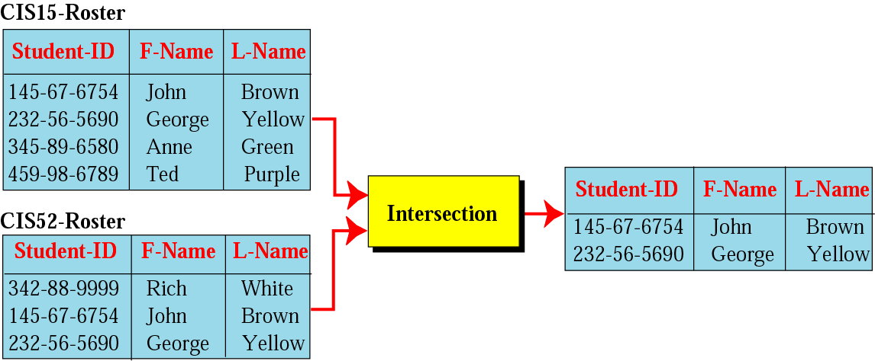
Intersection operation
Figure 14-14
A binary operation.
Creates a new relation in which each tuple is a member in both relations.
The two relations must have the same attributes.

Slide 11
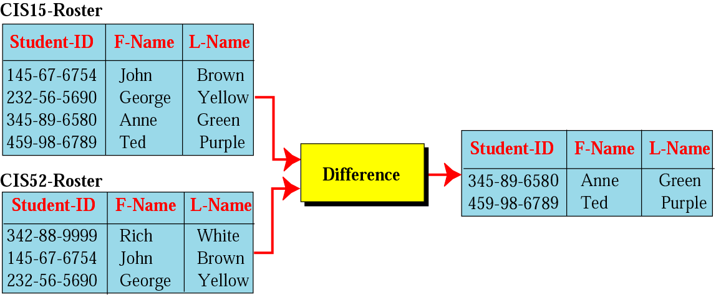
Figure 14-15
Difference operation
A binary operation.
Creates a new relation in which each tuple is in the first relation but not the second.
The two relations must have the same attributes.

Slide 12
STRUCTURED
QUERY
LANGUAGE

Slide 13
SQL (Structured Query Language)
Standardized by ANSI and ISO for use on relational databases.
It is a declarative (not procedural) language, which means that the users declare what they want without having to write a step-by-step procedure.
First implemented by Oracle in 1979.
SQL allows you to combine the following statements to extract more complex information from database.

Slide 14
Insert
insert into RELATION-NAME
values ( … , … , … )
insert into COURSES
values ( “CIS52”,”TCP/IP”, 6 )

Slide 15
Delete
delete from RELATION-NAME
where criteria
delete from COURSES
where No=“CIS19”

Slide 16
Update
update RELATION-NAME
set attribute1=value1, attribute2=value2, …
where criteria
update COURSES
set Unit=6
where No=“CIS51”

Slide 17
Select
select *
from RELATION-NAME
where criteria
select *
from COURSES
where Unit=5

Slide 18
Project
select attribute-list
from RELATION-NAME
select No, Unit
from COURSES

Slide 19
Join
select attribute-list
from RELATION1,RELATION2
where criteria
select No,Course-Name,Unit,Professor
from COURSES,TAUGHT-BY
where COURSES.No=TAUGHT-BY.No

Slide 20
Union
select *
from RELATION1
union
select *
from RELATION2
select *
from CIS15-Roster
union
select *
from CIS52-Roster

Slide 21
Intersection
select *
from RELATION1
intersection
select *
from RELATION2
select *
from CIS15-Roster
intersection
select *
from CIS52-Roster

Slide 22
Difference
select *
from RELATION1
minus
select *
from RELATION2
select *
from CIS15-Roster
minus
select *
from CIS52-Roster

